Slide 1
Demystifying Sovereign Sukuk
African Islamic Finance Summit
Salim Bharwani

Slide 2
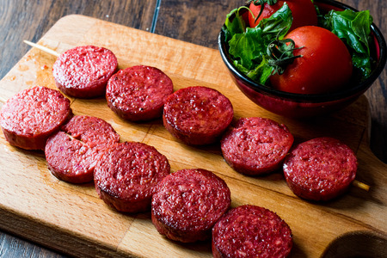
What exactly is a Sukuk?

Slide 3
Definition of sukuk
Accounting and Auditing Organisation for Islamic Financial Institutions (AAOIFI) definition of sukuk:
“...certificates of equal value representing undivided shares in ownership of tangible assets, usufruct and services or (in the ownership of) the assets of particular projects or special investment activity…”
Sukuk represent interests in underlying assets, groups of assets or business activity and must comply with the basic Sharia principles.
Sukuk market is increasingly becoming standardised (ijara, murabaha and mudaraba-wakala). This is a good thing - just like the conventional bond market and loan market association.

Slide 4
Conventional finance v Islamic finance
Bond: simply an ‘IOU’ - an instrument containing or evidencing the contractual debt obligation on part of the issuer.
Sukuk typically described as an ‘Islamic bond’ but this is not accurate.
They are akin to ‘Islamic investment trust certificates’ = ownership claim to the underlying asset!
Sukuk maintains economic characteristics that are equivalent to those of conventional bonds.
(1) Investors receive a revenue stream of payments;
(2) Less risky investment than equity; and
(3) Initially sold by the issuers.

Slide 5
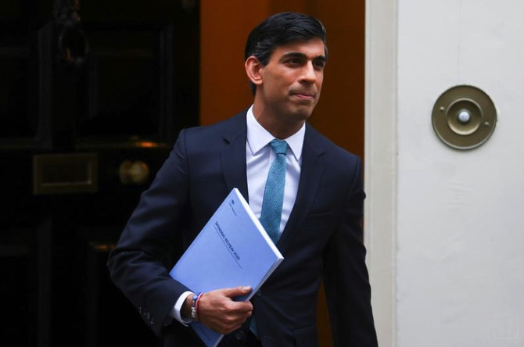
Why are Sukuk’s such a big deal?
Appeals to a broader base of investors = access to a wider and diversified investor pool!
“We’ve set out ambitious plans to make the UK the most open and dynamic financial center in the world. By launching our second sovereign sukuk, we’re cementing the UK’s position as the leading global hub for Islamic finance outside of the Islamic world.” (British Chancellor of the Exchequer - Rishi Sunak)

Slide 6
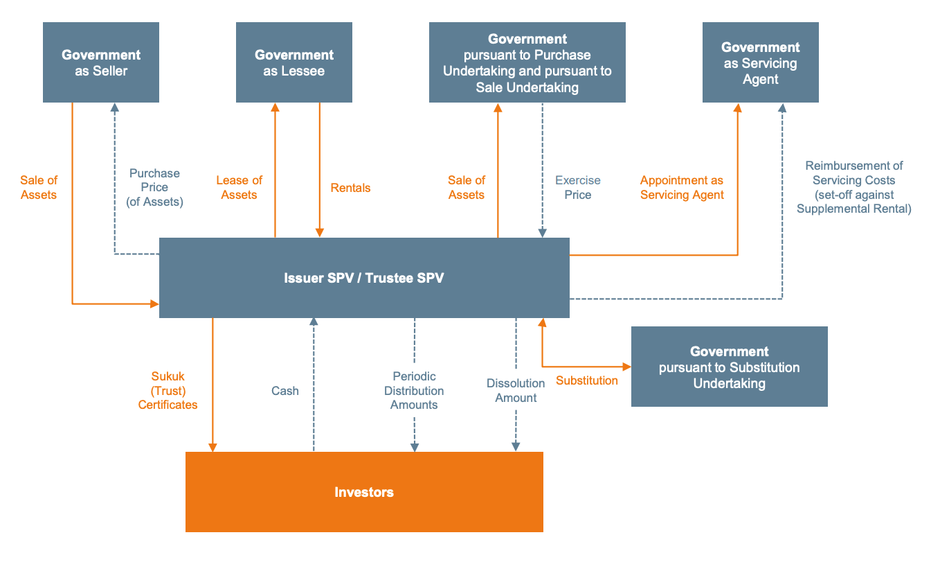
Demystifying a Sovereign Sukuk

Slide 7
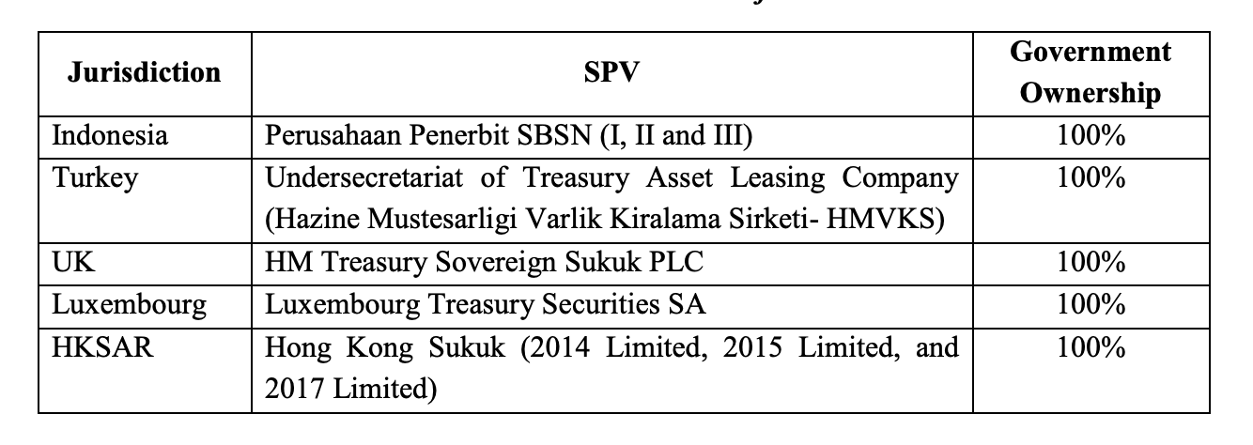
Sovereign Sukuk : Establishing a Legal Framework
The important role of the SPV

Slide 8
Sovereign Sukuk : Establishing a Legal Framework
Taxation is the key!
(1) Taxation of returns to certificate holders; and
(2) Raft of taxes, levies, costs and expenses generated by the underlying transactions and contracts involved in the Sukuk structure
There needs to be tax neutrality to make accommodations because conventional legislation does not fit with an unconventional financing technique such as Islamic finance.
Luxembourg laws - now stipulates sukuk is considered as a debt for tax purposes;
UK laws - removal of double charge on stamp duty when purchasing and reselling the assets; and
Hong Kong laws - income, expenditure, profits, gains or losses arising from underlying assets are regarded as those of the originator (the Government in our case not the SPV)
Notes:
The sukuk structure is complicated and multi-faceted
When it comes to the multiple transfer of assets between originator and issuer SPV, lease rental income, re-selling the asset back and passing on the income to investors, VAT on leasing arrangements
There are 101 taxes and stamp duties that would kick in which only reduces the attractiveness of the sukuk or makes it near impossible to structure and execute in the first place!
UK for example has issued a raft of changes to remove such barriers from the tax legislation that would become an obstacle to sukuk - requires a deeper understanding of the transaction and the ramifications.
As a lawyer I can’t stress this enough - details matter!

Slide 9
A Legal Framework facilitates Shari’ah compliance
Compliance with Islamic principles is integral for a successful Sukuk transaction.
A legal and regulatory framework that has impediments impacts the validity and credibility of a sovereign Sukuk issuance
The asset backed v asset based debate…
 | Asset-backed Sukuk | Asset-based Sukuk
Sukuk holder’s ownership | Legal ownership with right to dispose of underlying assets | Beneficial ownership with no right to dispose of underlying asset
Recourse | Sukuk holders cannot recourse to the originator (recourse only to underlying assets) | Sukuk holders can recourse to obligor (originator) if there is a shortfall in payments
Shari’ah compliance | Yes | No
Notes:
Largely due to the existing conventional laws and regulations (discussed in the previous slides) particularly around the taxation treatment of assets and sale and purchase transactions has led to a dilution (in my view) of the transaction structures and the issue of asset backed v asset based is a clear example!
With some very notable and high profile defaults, investors learned the hard way that most Sukuk instruments are not secured in the conventional sense.
You will recall at the beginning we made it very clear that a Sukuk is characterised as representing an undivided share in the ownership of a pool of tangible assets - the table clearly shows that this is now contingent on the DETAIL of the structure.

Slide 10
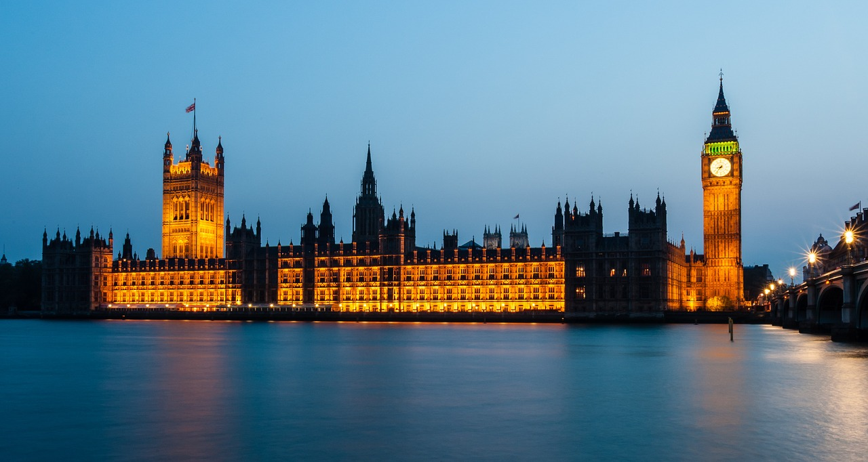
Can YOU own a portion of the below?

Slide 11
Finally...

